Slide 1
Review of Systems (ROS)
Kim Yung Pfuhl DNP, APRN, CNP

Slide 2

ROS
End of the subjective data gathering
“yes” or “no” questions
“head to toe”
Start fairly general
Often uncovers problems that the patient overlooked, or that they did not think were important
Particularly in areas unrelated to the present illness

Slide 3

Standard ROS questions
General: usual wt, wt loss, change in how clothing fits, weakness, fatigue, fever

Slide 4
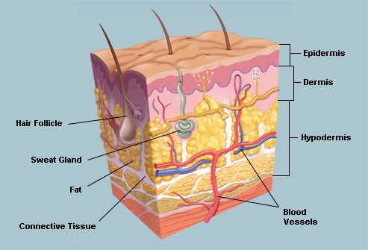
Skin
rashes
lumps
Sores
Itching
Dryness
changes in color
changes in hair or nails
changes in size or color of moles

Slide 5
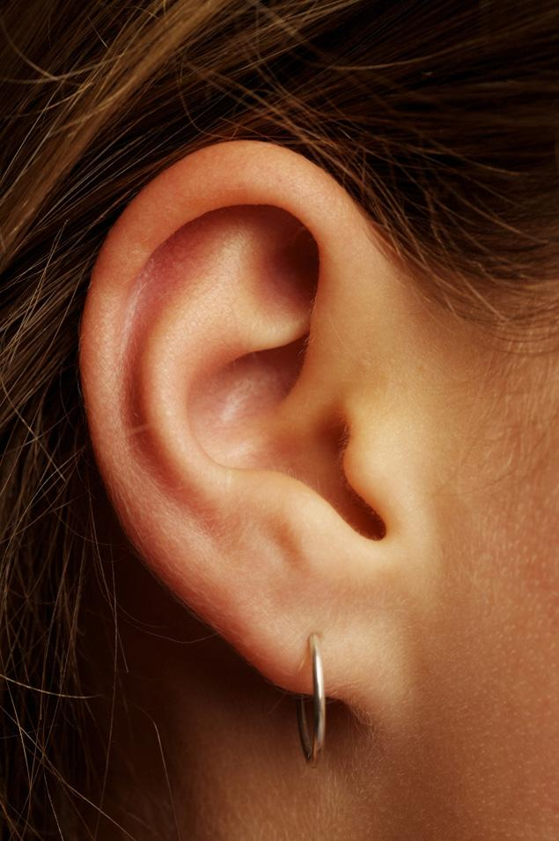
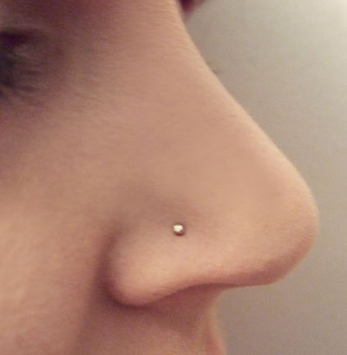
HEENT
Headache
Head injury
Dizziness
Vision
Glasses/contacts
Last eye exam
Pain, redness
Excessive tearing
Double/blurred vision
Spots
Flashing lights
Glaucoma/cataracts
Hearing
Tinnitus
Vertigo
Earaches, infection, discharge
Use of hearing aids
Frequent colds
Nasal stuffiness/discharge
Itching/hayfever
Nosebleeds
Sinus trouble
Bleeding gums
Tooth pain
Dentures
Last dental exam
Sore tongue/ dry mouth
Frequent sore throats/hoarseness

Slide 6
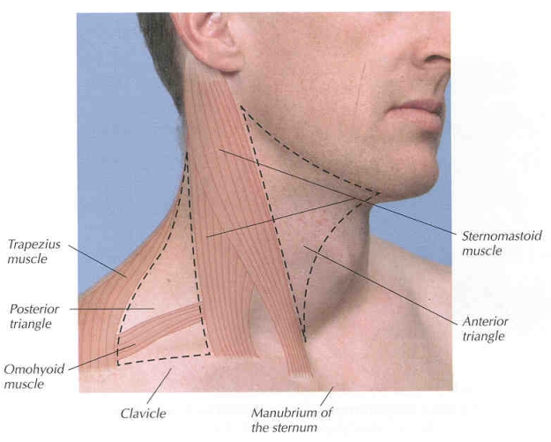
Neck
Swollen glands
goiter
Lumps
Pain
Stiffness

Slide 7
Breasts
Lumps
Pain
Discomfort
Nipple discharge
Self-exam practices

Slide 8
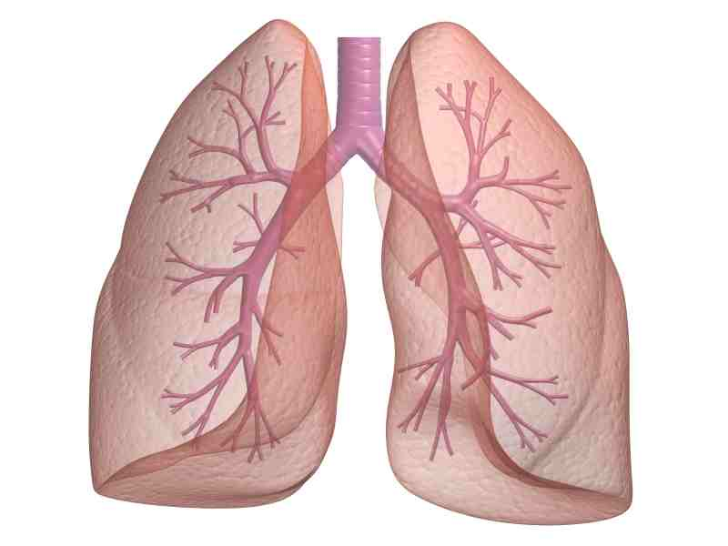
Respiratory
Cough
Sputum (color, quantity)
Hemoptysis
dyspnea
Wheezing
Pleurisy
Last CXR

Slide 9
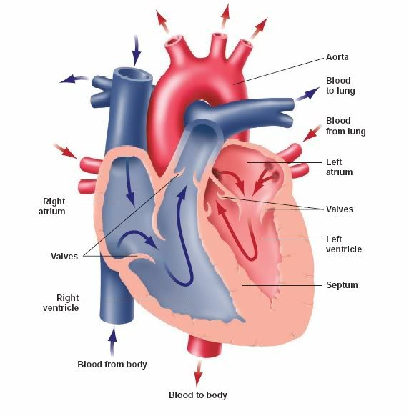
Cardiovascular
“heart trouble”
High blood pressure
Rheumatic fever
Heart murmurs
Edema
Past EKG results
Chest pain
Palpitations
Dyspnea
orthopnea

Slide 10
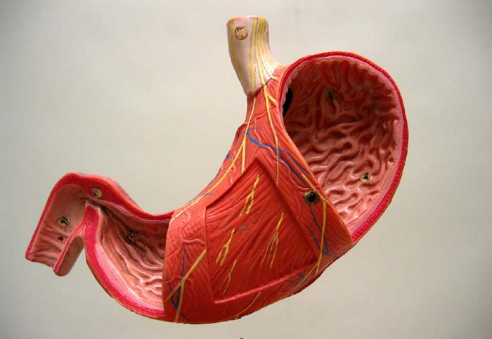
Gastrointestinal
Dysphagia
Heartburn
Appetite
Nausea
Rectal bleeding
Black or tarry stools
Abdominal pain
Food intolerance
Bowel movements
Stool color and size
Change in bowel habits
Pain with defecation
Hemorrhoids
Constipation
diarrhea
Excessive belching/flatus

Slide 11
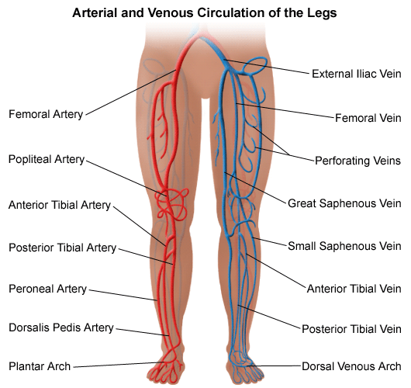
Peripheral vascular
Intermittent claudication
Swelling in calves, legs, feet
Color changes in fingertips/toes in cold weather
Leg cramps
Varicose veins
Hx of DVT
Swelling with redness or tenderness

Slide 12
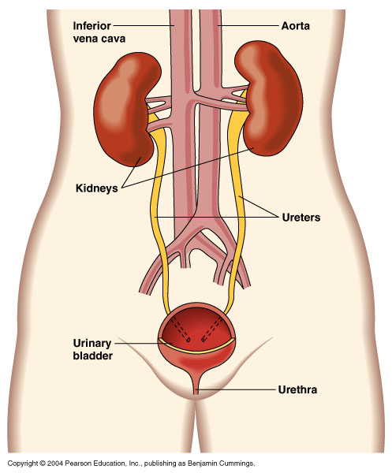
Urinary
Frequency
Polyuria
Nocturia
Hematuria
Suprapubic pain
Decreased force of urinary stream
Urgency
Burning/pain with urination
UTIs
Kidney/flank pain
Incontinence
Hesitancy
dribbling

Slide 13
Genital- anatomic male
Hernias
Discharge/sores from penis
Testicular pain/masses
Birth control methods/condom use
Scrotal pain/swelling
STI hx
Sexual habits, interest, function, satisfaction
HIV concerns

Slide 14
Genital- anatomic female
Age at menarche
Regularity/ frequency/duration of periods
Dysmenorrhea
Age at menopause
Number of pregnancies/number & type of deliveries/complications
Bleeding between periods or after intercourse
Last menstrual period
Vaginal discharge/itching/sores/lumps
Birth control method
Sexual preference/interest/function/satisfaction
HIV concerns

Slide 15
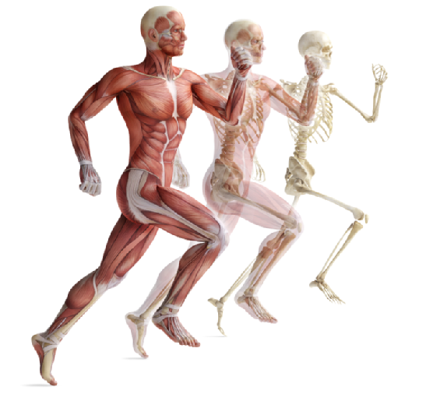
Musculoskeletal
Muscle/joint pain
Stiffness
Arthritis
Gout
Limitation in ROM
History of trauma
Backache
Location of affected joints/muscles
Swelling/redness/pain
Tenderness/stiffness
Joint pain with fever, chills, rash, anorexia, wt loss

Slide 16
Psychiatric
Nervousness
Tension
Mental health dx
Mood
Memory change
Suicide attempts

Slide 17

Neurologic
Changes in mood, attention, or speech
Headache
Dizziness
Vertigo
Fainting/blackouts
Tremors
seizures
Changes in orientation, memory, insight, or judgment
Weakness/paralysis
Numbness or loss of sensation
Tingling / “pins and needles”

Slide 18
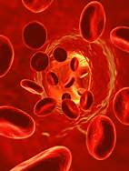
Hematologic
Anemia
Past transfusions
Easy bruising or bleeding
Transfusion reactions

Slide 19
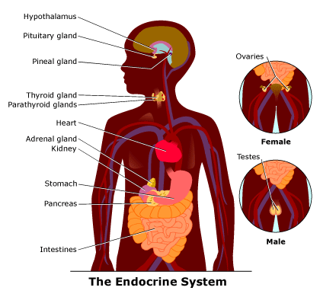
Endocrine
“thyroid trouble”
Excessive thirst or hunger
Heat or cold intolerance
Excessive sweating
polyuria
Change in glove or shoe size

Slide 20
Documenting ROS
The right way:
Skin: Patient denies any rashes, lumps, or sores. Reports dryness and itching during the winter months. Denies changes in skin color or hair and nails. Has not noted any change in size or color of moles which he checks monthly.
The wrong way:
Skin: Denies problems.

Slide 21
DNP students: Documenting ROS
Some of the data may need to be moved to PMH or HPI sections
If you have already asked about something when obtaining your OLDCARTS data you can then write “see HPI”
You do not want to be documenting the same data in numerous places. Need to decide where the data best fits in the H&P documentation. This is often done for you already in EMR systems.

